Slide 1
Re-use rocket for next Mission
Re-use rocket for next mission

Slide 2
Introduction
SpaceX is a revolutionary company who has disrupt the space industry by offering a rocket launches specifically Falcon 9 as low as 62 million dollars; while other providers cost upward of 165 million dollar each. Most of this saving thanks to SpaceX Outstanding idea to reuse the first stage of the launch by re-lands the rocket to be used on the next mission. Repeating this process will make the price down even further. As a data scientist of a startup rivaling SpaceX, the goal of this project is to create the machine learning pipeline to predict the landing outcome of the first stage in the future. This project is crucial in identifying the right price to bid against SpaceX for a rocket
Launch.

Slide 3
Basic Problems
Identifying all the factors that influence the landing outcomes
The Relationship among the Variables and how it affects outcomes
The Best Condition needed to Increase the probability of successful landing.

Slide 4
Methodology
Data Collection
Data Wrangling
Data Visualization
Exploratory Data Analysis (EDA) with SQL
Interactive Map with Folium
Dashboard with Plotly Dash

Slide 5
Data Collection
Data Was Collected using SpaceX REST API and web scrapping form Wikipedia.
For REST API, we send request to the server, then, we get the response content as Json and we convert it in to pandas dataframe using json_nomalize(). We than clean the data, checked for missing value and fill with whatever needed.
For web scrapping, we will use the BeautifulSoup to extract the launch records as HTML Tables, and then we convert the tables in to pandas DataFrame for further analysis.

Slide 6
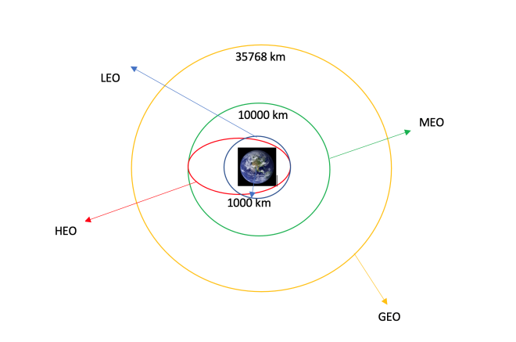
Data Wrangling
Data wrangling is the process of cleaning and unifying messy and complex data into simple and readable form for Exploratory Data Analysis.

Slide 7
Data Visualization
We start by using scatter graph to find the relationship among the attributes such as:
Payload and flight Number.
Flight Number and Launch Site.
Payload and launch Site.
Flight Number and Orbit Type.
Orbit type and Payload Mass.

Slide 8
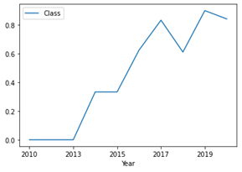
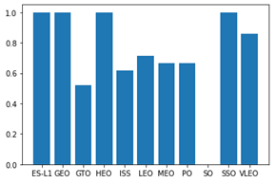
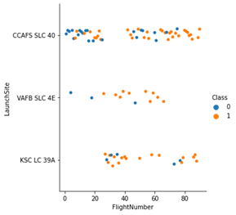
Data Visualization

Slide 9
Exploratory Data Analysis (EDA) with SQL
We perform many queries of SQL to get better understand the dataset. Example
Displaying the name of launch sites
Displaying the total payload mass carried by the booster version F9 v1.1.
Displaying the average payload mass carried by the booster version F9 v1.1.
Listing the date when the first successful landing outcome in ground pad was archived.
Listing the name of boosters which have success in drone ship and payload mass greater than 4000 but lower than 6000.
Listing of total number of successful and failure mission outcomes.
Listing the name of boosters which carry the maximum payload masses.

Slide 10
Interactive Map with Folium
To visualize the launch data in to interactive map, we took coordinates at each site and add a circle marker around each site with the label name of launch site.
We assigned launch outcome (Success and failure) with green and red color.
We use Haversine’s formula to calculate the distance between launch site and various landmarks such as railways, highways, and coastline and nearby cities.

Slide 11
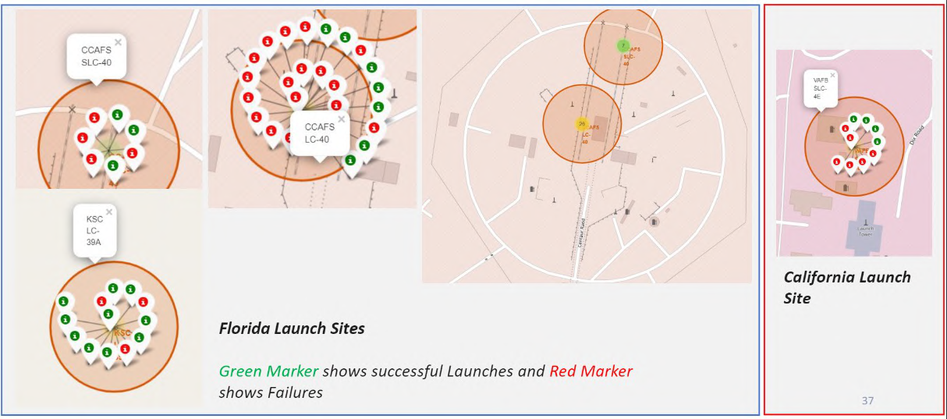
Interactive Map with Folium

Slide 12
Dashboard with Plotly Dash
We build an interactive dashboard with Plotly Dash which allowing the user to play around with the data as they need. We plat a pay chart showing total launches by certain sites. And we plot a scatter graph shows the relation between outcomes and Payload masses (Kg) for different booster version.

Slide 13
Dashboard with Plotly Dash

Slide 14
Results
The payload mass is greater than 7000 Kg, the probability of success rate is highly increase. However there is no clear pattern to say that Launch site is dependent on the payload mass for Success rate.
Heavier payload has positive impact on LEO, ISS and P0 orbit. However, it has negative impact on MEO and VLEO orbit. GTO orbit seem to depict no relation between the attributes. Meanwhile, again, SO, GEO and HEO orbit need more dataset to see any pattern or trend.
Increasing trend from the year 2013 until 2020. If this trend continue for the next year onward. The success rate will steadily increase until reaching 1/100% success rate.

Slide 15
Conclusion
The Tree Classifier Algorithm is the best machine learning approach for this data.
The low weighted payload (less than 4000 Kg) performs better than heavy weighted payloads.
The Success rate of SpaceX launches increasing with time, which it eventually perfect the launches in future.
KSC LC-39A has more successful launches rate i.e. 76.9%.
SSO orbit has more successful rate; 100% and more then one occurrence.

